Slide 1
KHATRA ADIBASI MAHAVIDYALAYA P.O- Khatra, Dist.-Bankura, West Bengal, Pin-722140 Name of the Teacher- Swarnava Chakraborty Class- Semester - I Subject- Physical Education Course Tittle : History and Foundation of Physical Education and sports
Topic- Growth and Development Session: 2023-24

Slide 2
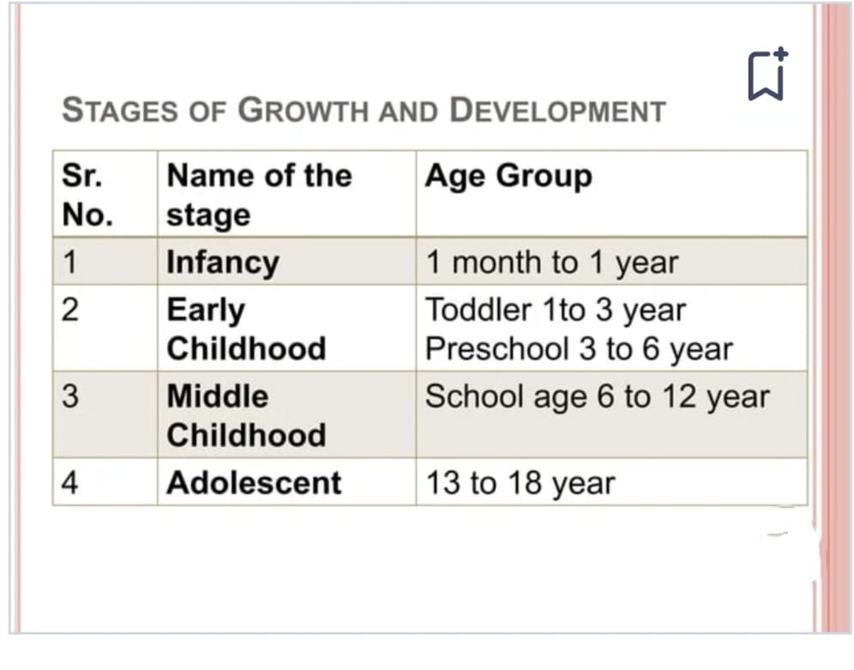

Slide 7
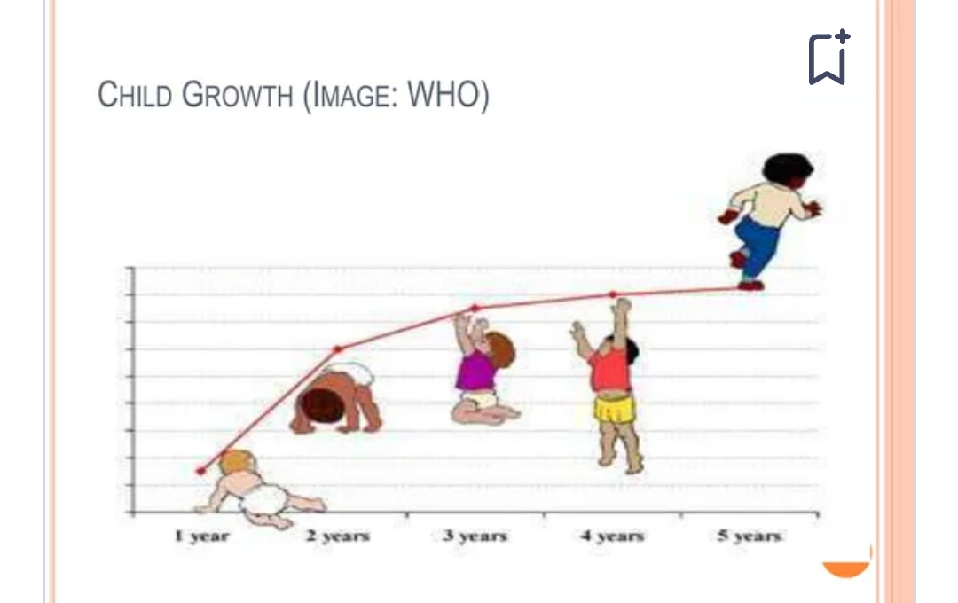

Slide 8
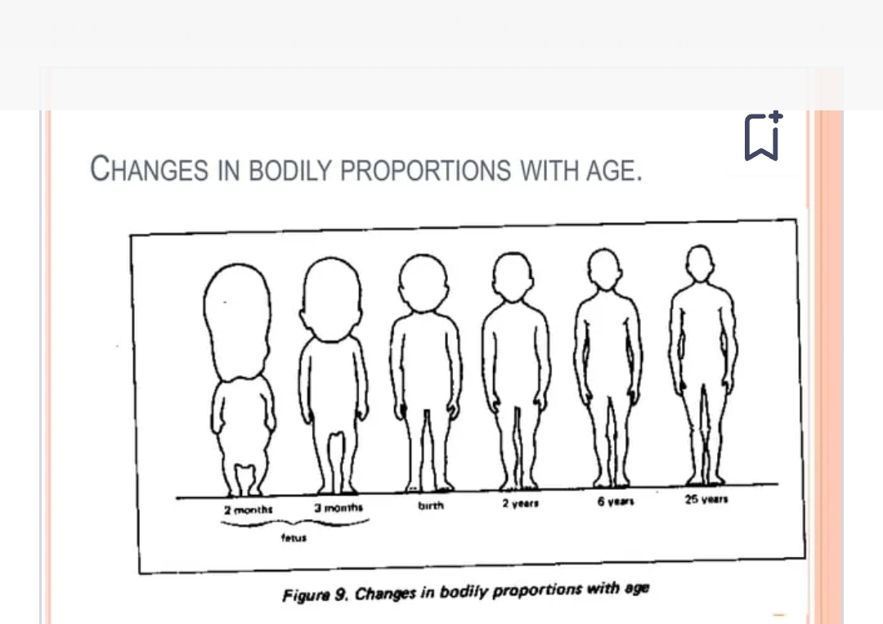

Slide 12
References
Book Name -Child Growth and Development
Authors:
Jennifer Paris
Antoinette Ricardo
Dawn Rymond
Alexa Johnson
Publisher: College of the Canyons

